Slide 1
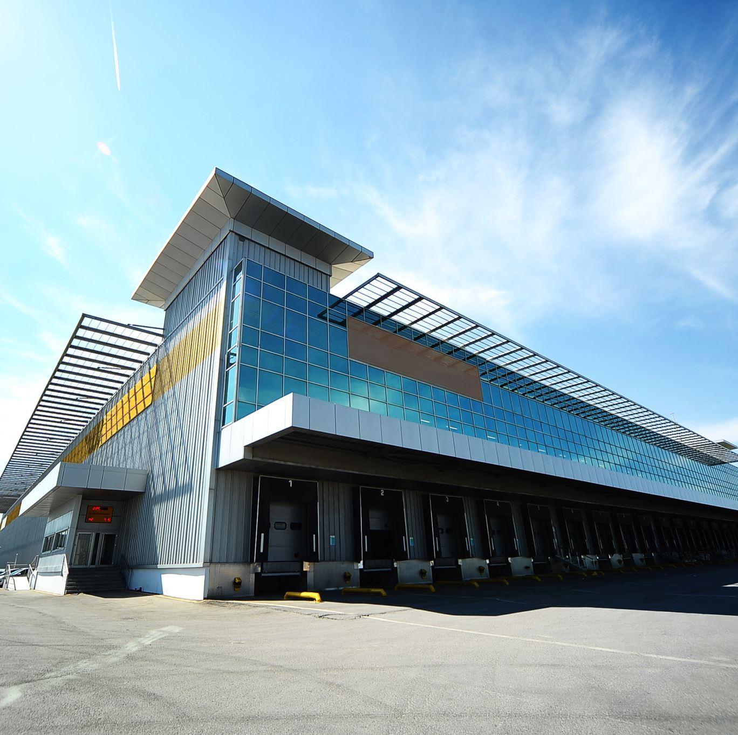
Transfer of Commercial Enterprise
Total transfer of all assets and debts
Commercial enterprise transfer agreement. In written form
Registration in trade registery. Establishment effect
Announcement by Türkiye Trade registery Gazette

Slide 2
The scope of the commercial enterprise transfer:
Fixed assets (Immovable)
Right of tenancy
Bussines value
Trade name, Bussines name
Other intellectual and industrial property rights
Elements allocated to the bussines on a continuous basis
Excluding must be clearly underlined

Slide 3
Provisions / Consequences of Transfer
All assets (rights) and debts (liabilities) are transfered to the transferee
Joint responsibility of both transferor and transferee (2 years)
Expectionally transferor's being subject to bunkcrupcy (1year)

Slide 4
Commercial Jurisdiction
Commercial cases / lawsuits,
Courts that hear commercial cases,
Special procedural rules to be applied in commercial cases,

Slide 5
Commercial Cases / Lawsuits:
Common feature: Commercial cases are subject of civil cases.
Absolute Commercial Cases
Commercial Cases Arising from Remittance Agreement, Retention Agreement and Copyright
Relative Commercial Cases

Slide 6
Absolute Commercial Cases:
Cases arising from TCC
Cases arising from other legislative sources determined in TCC

Slide 7
Commercial Cases Arising from Remittance
Agreement, Retention Agreement and Copyright:
Additional condition / requirement: cases concern the commercial enterprise of at least one of the parties of the conflict

Slide 8
Relative Commercial Cases
Aggravated condition: Cases concern the commercial enterprises of both parties separately.
Competent Courts in Commercial Litigation

Slide 9
Relative Commercial Cases
The court in charge: the commercial court of first instance.
If commercial court of first instance does not established: the civil court of first instance is charged

Slide 10
Special Procedural Rules to be Applied in Commercial Cases / Lawsuits
Principle: The procedural rules to be applied in commercial cases are essentially the same as the general procedural rules to be applied in non-commercial cases.
Exception: Specific rules are determined.

Slide 11
Procedural judicial rules, exceptionally specific to
commercial cases
Evidence function of commercial books
Commercial affair presumptions
Loss certificate
Simple trial procedure in cases related to commercial companies
Structure of commercial courts of first instance
Mandatory mediation process

